Slide 1
How to Fund Canadian Accessibility Projects in 2026
May 27, 2026
Notes:
On screen at beginning of webinar
Trish and Noah self-intros: Name, pronouns, organization and role, why accessibility is important to us, and a bit about the organization.

Slide 2
About Untapped
Since our launch in October 2022, Untapped Accessibility has become a leading Canadian accessibility consulting firm.
As a certified social enterprise, we have a dual purpose:
Generate revenue for the Open Door Social Services Society
Create work opportunities for professionals with disabilities
Our impact to date
225+ Clients served
7,000+ Participants trained
20+ Accessibility plans developed
16,000+ hours provided by disabled professionals
Notes:
Trish

Slide 3
Untapped's services
Legislation compliance – writing accessibility plans, creating and engaging committees, designing feedback processes
Grant writing – drafting grants for projects we’ll partner on
Accessibility audits – built environment, digital, and policy
Workplace accessibility – physical and digital space assessments, policy review and design, framework development
Training – general or customized training, e-learning, guides
Barrier identification – community engagement, think tanks, policy scans
Notes:
Trish

Slide 4
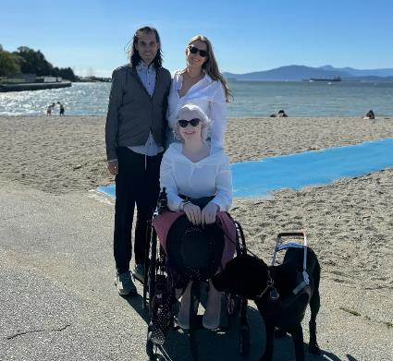

About Easy Surf
Easy Surf is a disability-led digital accessibility consultancy based in Vancouver, BC. Our services are provided by people with disabilities.
Our core services are:
Website development and design
Website accessibility auditing
Document accessibility
Visit our website and follow us on LinkedIn to learn more!
Notes:
Noah

Slide 5
Accessibility for the session
Accessible slide deck available in advance of session by request
Live captions with option to view in Streamtext
ASL interpretation
Session is being recorded
Multiple ways to engage: chat, Q+A, raise your hand and we can enable your camera
Notes:
Noah
Sarah share streamtext link in chat https://www.streamtext.net/player?event=UA
Also note, we'll be sending an aftercare package that includes details of the funding opportunities described by the panelists and a few others we know about.

Slide 6
Agenda
Finding funding
Setting your priorities
Writing the application
Strengthening your application
Measuring your impact
Success stories
Support for your organization
Q and A
Notes:
Noah

Slide 7
Finding funding
Notes:
Noah

Slide 8
Grant types
Capital grants: Ramps, doors, washrooms, recreation facilities.
Often larger, with longer timelines and matching fund requirements.
Project grants: Training, tools, software, websites, research.
Generally faster turnaround and smaller dollar amounts.
Operational and core funding: Staff and program costs.
Less common for accessibility funding.
Notes:
Noah

Slide 9
Grant funders
Federal
Provincial
Municipal
Foundations
Corporate
Nonprofit
Each funder has its own goals, timelines, and eligibility rules.
Notes:
Noah

Slide 10
Funding structures
Matching funds: many grants, especially capital, require matching contributions.
Match ratios vary
In-kind contributions such as staff time, donated materials, and volunteer hours sometimes count.
Continuation: some grants require the project to continue after funding ends.
Read the funding ratio carefully before applying.
Notes:
Noah

Slide 11
Where to look
Finding grants can be challenging.
Listings are scattered across multiple sources.
Many opportunities are announced through email lists, networks, or on funder websites.
We are trying to change that!
Notes:
Noah

Slide 12
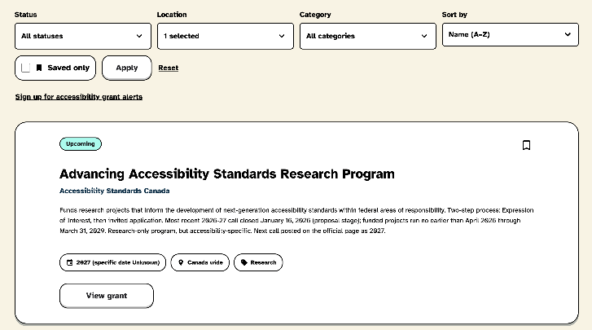
Easy Surf Grant Finder
A free database listing every accessibility specific grant in Canada.
Optional newsletter for alerts: grants only, nothing else.
Notes:
Noah
Sarah add to chat https://easysurf.ca/grants/

Slide 13
Poll question
What holds you back from applying for accessibility grants?
Not enough time
No clear priorities
Hard to find grants
Cannot match or contribute funding
No team to write
Notes:
Noah
Trish: Launch poll!

Slide 14
Setting your priorities
Notes:
Trish

Slide 15
Identify a barrier
Start with a barrier: what is stopping people from accessing your space, services, or information?
Built environment: doors, ramps, washrooms, signage.
Services: training, communications, policies.
Digital: website, software, documents.
Prioritize barriers that have the greatest impact on people with disabilities.
Consider feedback you’ve heard from disabled people you serve.
Notes:
Trish

Slide 16
Align your priorities with funders
A great project that does not match a funder’s stated goals will not be funded.
Review the funder’s recently funded projects.
A focused project is more fundable than a broad one.
Notes:
Trish

Slide 17
Build a case for support
Explains to funders why they should fund you
Provides a reusable framework to guide all funding applications
Today, we’ll help you build an outline for yours!
Notes:
Trish
Add document to the chat

Slide 18
Activity 1
Let’s start building your case for support together!
Step 1: Identify a barrier
What barrier impacts people with disabilities?
Who is affected?
Share in the chat.
We will continue to build throughout the presentation.
Notes:
Trish

Slide 19
Writing the application
Notes:
Trish

Slide 20
Describe your organization
Include your mission, and the community you serve.
Be clear about the need you address, who benefits from your work, and how.
Use the funder’s language, read their priorities, then describe yourself in those terms.
Explain why this is the right moment for this project.
Notes:
Trish
You may already have this as a boiler plate on your about us page from your website

Slide 21
Demonstrate the barrier
Describe the barrier you’d like to remove.
Who is impacted?
How are they impacted?
How can you demonstrate it?
Data, surveys, community feedback, focus groups, third-party reports.
How can you remove the barrier?
Notes:
Trish

Slide 22
Activity 2
Let’s continue building your case for support!
Step 2: Describe your solution and who shapes it
How will you remove the barrier?
Why is your organization positioned to lead this work?
Take a moment to think about it.
Share in the chat.
Notes:
Trish

Slide 23
How to budget
Itemize every line and group by category.
Get vendor quotes for large expenses.
Make sure you’re clear about what is fundable and what is not.
Connect each line to a project activity.
Don’t forget to plan for accessibility service costs.
Notes:
Trish

Slide 24
Plan for your contribution
Match categories as the funder defines them.
List the source of your funds.
Build in a contingency of 5% to 10% for surprises, if allowed.
Include overhead costs of 10% to 15%, if allowed.
Understand which costs are ineligible and how you will fund them.
Capture any in-kind contributions from your organization and partners.
Notes:
Trish

Slide 25
Why applications get rejected
Priorities did not align.
Budget was unclear.
Application did not follow the funder’s instructions.
Eligibility criteria were not met.
Funding call received more applications than could be funded.
Applicant did not qualify based on business structure.
Notes:
Trish

Slide 26
Strengthening your application
Notes:
Noah

Slide 27
Include people with disabilities
Meaningful participation means:
Accessibility of the entire process has been carefully considered.
People with disabilities on the project team.
Wider disability community is consulted.
People with disabilities who provide feedback are compensated.
Action is taken based on the feedback that is gathered.
Notes:
Noah

Slide 28
Activity 3
Let’s continue building your case for support!
Step 3: Include people with disabilities
How will people with disabilities lead, shape, contribute to, or evaluate this work?
Take a moment to think about who and how.
Share in the chat.
Notes:
Noah

Slide 29
Demonstrate your track record
Share examples of past work, with metrics.
Try to quantify people served, projects completed, outcomes achieved.
If you are a new organization, use internal experience instead.
Notes:
Noah

Slide 30
Write in plain language
Write and structure your application so grant managers can find and understand the information easily. Where possible, follow the same order the funding call uses.
Use headings and point form lists to allow for easy comparison between sections in the application and your submission.
Consider using AI to help you meet word count restrictions.
Use familiar words and avoid jargon as grant managers may not be experts in your sector.
Use an active voice and aim for one idea per sentence.
Consider asking a friend or colleague from a different sector for feedback.
Notes:
Trish
Speak of cognitive load

Slide 31
Break
5 minutes
Notes:
Noah

Slide 32
Measuring your impact
Notes:
Noah

Slide 33
What you can measure
Easier to measure
Harder to measure
Number of people provided products or services
Structures built
Amount of equipment provided
Survey responses
Attitude change
People who still encounter barriers
Long term data
Number of people who took the training
Notes:
Noah

Slide 34
Activity 4
Let’s continue building your case for support!
Step 4: Show the impact
What changes when this work is done?
How will you know?
Take a moment to think about what and how.
Share in the chat.
Notes:
Noah

Slide 35
Activity 5
Let’s continue building your case for support!
Step 5: Funding needs
What are some key cost categories?
Take a moment to think about what’s needed.
Share in the chat.
Notes:
Noah

Slide 36
Finish your case for support
Our five activities have helped build the outline for your case for support
Next, complete it so you can adapt it for many funders
When you discover a new funding opportunity:
Identify the priorities
Adapt your case for support into an application
Notes:
Noah

Slide 37
Don’t give up!
Rejection is normal; most grant applications are rejected.
Ask for feedback; some funders will provide this.
Repurpose parts of your application to make future ones easier and faster.
Continue to build the relationship; stay in touch with funders.
Notes:
Noah

Slide 38
Stories from successful projects
Notes:
Noah

Slide 39
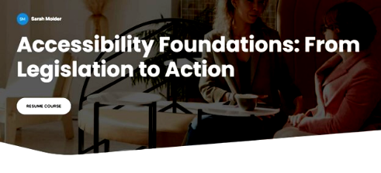
Large project: E-learning for all staff
Client: Regional Government
Challenge: Existing staff and future staff need common understanding of accessibility, at their own pace.
Our support: Two-hour Foundations of Accessibility session for all staff offered virtually and recorded.
Budget range for similar scope: $25,000 to $40,000
Details: 45-minute online course for existing staff and elected officials to understand key concepts, legislative requirements and perspectives of disabled community members
Impact: Enduring learning opportunity that will ensure new staff and new elected officials can be brought up to speed on accessibility work.
Notes:
Trish
Benefits of e-learning when you have upcoming elections and expected turn over
How we've supported organization to get their funding. Untapped is happy to meet with you to help you scope your grant project and explain how we could help you achieve the project goals. We can provide a proposal with costing for any of the items you'd want our help with. For larger projects where Untapped would be very hands on, we've also taken on drafting the grant for the nonprofit. Of course with the expectation that if the grants is successful, Untapped would be your partner.

Slide 40

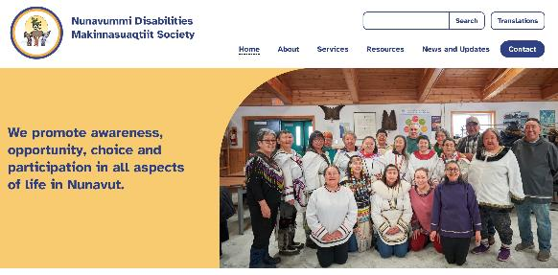
Large project: NDMS rebuild
Project details: WordPress web development, design, accessibility testing, training
Budget range for similar scope:
$15,000 to $30,000
Impact:
WCAG 2.2 AA conforming website
Easier to navigate and find resources
Design organizes content without overwhelming
Built in partnership with KunStudios and Harper Learning
Notes:
Noah

Slide 41
How we can help
Easy Surf maintains an accessibility grant database and newsletter.
Untapped can help write or review your grant application.
Untapped and Easy Surf provide services that remove barriers.
With funding in place, you can hire us to help with:
Community consultation
Digital audits and website updates
Training staff
Notes:
Noah

Slide 42
Aftercare package coming next week
Registrants will receive:
Slides
Case for support template
Captioned recording of the session
Transcript
Event summary
Notes:
Noah

Slide 43
Session evaluation
SurveyMonkey
Notes:
Trish https://www.surveymonkey.com/r/FundingAccess

Slide 44
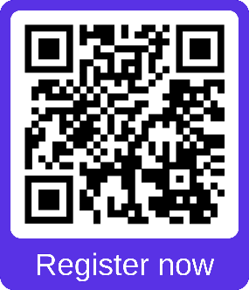
Up next: Plain language for employers
Thursday June 18th
10:00 am -11:30 am Pacific (1:00 pm – 2:30 pm Eastern)
A hands-on webinar that will help you apply plain language practices to how you communicate with candidates and employees.
Bring a 1-page document such as a job posting, policy, or candidate communication to workshop during the session.
PlainLanguageEmployers.eventbrite.ca
Notes:
Trish
Plain Language for Employers registration link: https://PlainLanguageEmployers.eventbrite.ca

Slide 45

Get in touch!
Easy Surf
Untapped Accessibility
Noah Senecal-Junkeer, Co-Founder and Team Lead
noah@easysurf.ca
easysurf.ca
Book a meeting with me
Trish Kelly, Managing Director
trish@untappedaccessibility.ca
untappedaccessibility.ca
Book a chat with me
Notes:
Both

Slide 46
Q&A
Notes:
Both

